Slide 1
Unit-2 2G Networks
Introduction
GSM
GSM Services
Architecture
By Jasleen Kaur GSM Interface
GTBIT (IT Dept)

Slide 2
Introduction
The second generation (2G) cellular systems provide more facilities and attractive features than first generation (1G) systems.
The 2G standards rely on digital formats including TDMA/FDD and CDMA/FDD.
2G standards provide:
Better speech quality
High speed data application
Efficient spectrum usage and compatible with TDMA access scheme.
Support multiple users.

Slide 3
The TDMA technique is used by 2G standards that include Global system for mobile (GSM). The TDMA schemes use half duplex method. Other TDMA feature include:
Good Synchronization
For better operations, it possesses guard intervals.
Efficient spectrum utilization.
Operates with faster data rates.
With CDMA technique, every subscriber is assigned a n-bit code and it guarantees high degree of security than other access techniques.
Thus, TDMA and CDMA in 2G standards provide less design complexity, more security, faster speeds of transmissions and high reliability than 1G systems.

Slide 4
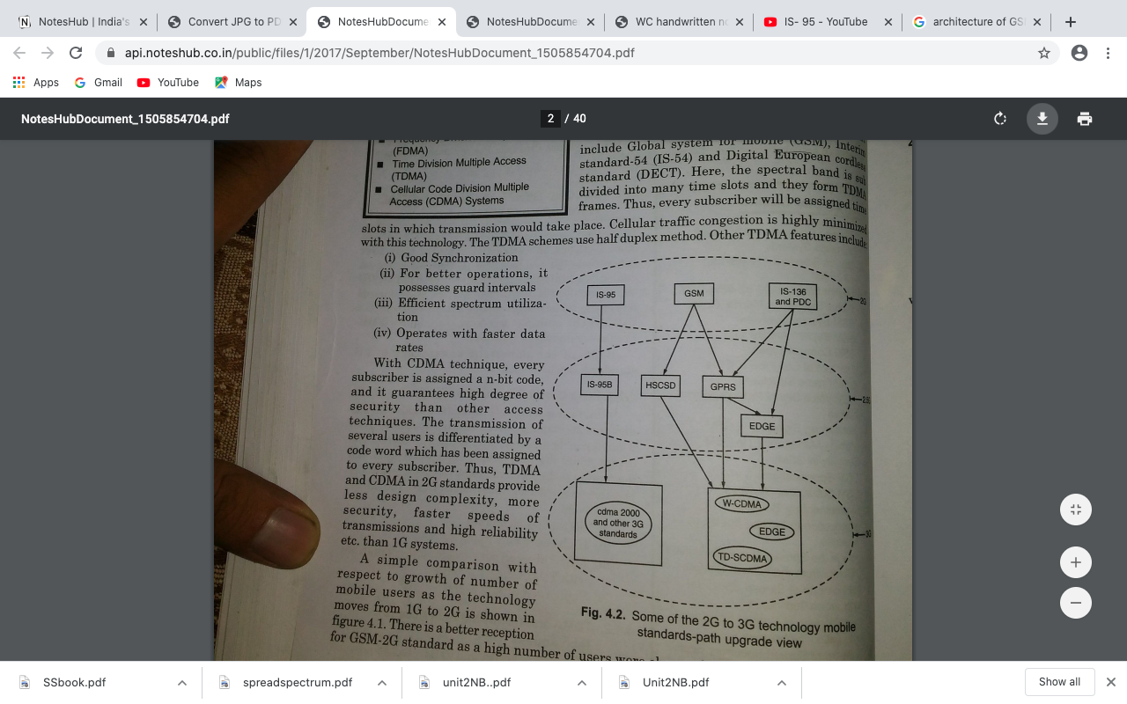

Slide 5
IS-136 (D-AMPS):
It stands for Interim standard-136.
The analog mobile phone system (AMPS) was not suitable to support high traffic and demands for high capacity.
In 1980’s USDC came into existence to accommodate multiuser with frequency spectrum allocated.
USDC/AMPS was standardized as IS-54, It allows dual mode systems.
Salient Feature of USDC:
The USDC system uses frequency reuse technique.
It provides high cellular capacity.
It accommodate many users.
It was also called North America Digital Cellular Standard(NADC).
USDC shares same frequencies with minimized interference.

Slide 6
Salient Feature of IS-136
It operates in 800-1900 MHz frequency band.
Its channel bandwidth is 30kHz.
The TDMA frame with 40 msec in 6 time slots is being used in it.
Six time slots: (channel data rates)
1st time slot –Half rate channel
2nd , 5th time slots- Full rate channel
2nd,3rd, 5th ,6th time slots- Double rate channel
v. The data link layer of IS-136 provides,
Addressing
Flow Control
Error detection
Segmentation
Media Access Control

Slide 7
vi) Network layer allows:
Establishments
Maintaining
Termination of connection
It possesses channels namely,
Digital Control Channel
Digital Traffic channel

Slide 8
IS-95 (CDMA):
Interim standard 95.
It can tolerate interference with spread spectrum technique.
It provides high security.
It helps in achieving high capacity land mobile communication systems.
Salient Feature of IS-95:
It uses speech coder Qualcomm, code Excited Linear Predictive Coder, which can detect voice activities & reduce data rates upto 1200 b/sec in silent period.
It permits every subscriber within a cell to make use of radio channel where same radio channel is used by subscribers of adjacent cells too. This is possible with direct sequence spread spectrum (DSSS) technique.

Slide 9
iii. It uses specific modulation and spread spectrum techniques in its forward as well as reverse links.
It is compatible with IS-41 networking standard.
Channels and frequencies used in IS-95:
Forward Link: 869-894 MHz
Reverse link: 824-849MHz
For cellular operation, channel pair separated by frequency of 45MHz.
Total Spreading factor is 128 (chip rate of 1.228 M chips/sec)

Slide 10
GSM (Global System for Mobile):
The main aim was to provide ‘roaming facility’ for subscribers & to follow ISDN guidelines.
Its is first 2G cellular network.
2G network developed as a replacement for first generation (1G) analog cellular networks.
The GSM standard originally described a digital, circuit –switched network optimized for full duplex voice telephony.
Basic Requirement:
Service Portability
Quality of Service
Frequency utilization (Reuse)
Cost
Security

Slide 11
Performance characteristic of GSM:
Communication: wireless digital communication; support for voice and data services.
Total mobility: international access
Worldwide connectivity: The network can handles localization
High Capacity: Better frequency efficiency
High Transmission Quality: high audio quality, uninterrupted phone calls at higher speeds, Better handoffs
Disadvantages:
High complexity of the system
Several incompatibilities within the GSM standards
No end to end encryption of data.

Slide 12
GSM Service:
GSM services follow ISDN guidelines and are classified as either Teleservices or Data services. Teleservices include standard mobile telephony and mobile originated or base originated traffic. Data Services include computer- to computer communication and packet switched traffic. User services divided into three categories:
Bearer Services (Related to1,2 and 3 layer of OSI, Data service 300bps to 9.6kbps.)
Telephone Services (voice transmission, Message service and data communication, Emergency calls, SMS, MMS)
Supplementary Services ( call forwarding, call redirecting)

Slide 13
GSM Architecture:
The GSM system architecture consists of three major interconnected subsystems that interact with between themselves and with the users through certain network interfaces. The subsystems are the Base station Subsystem (BSS), Network and switching Subsystem(NSS) and the Operation Support Subsystem(OSS). The mobile station(MS) is also a subsystem, but is usually considered to be part of the BSS for architecture purposes.

Slide 14
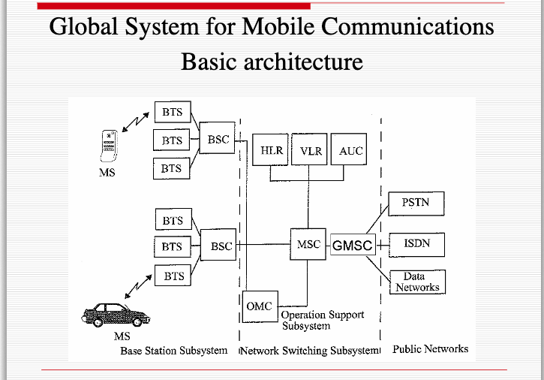

Slide 15
Base Station Subsystem(BSS): The BSS provides and manages radio transmission path between the Mobile Station(MS) and the mobile Switching Centre(MSC). It also manages radio interface between the mobile stations and all other subsystems.
Mobile Stations(MS): The MS communicates the user information and modifies it according to the transmission protocols of air-interface to communicate with other BSS equipment. The MS has two elements, Mobile equipment(ME) and Subscriber Identity Module (SIM).
Two Elements in BSS: Base Transceiver Station(BTS) & Base Station Controller(BSC)

Slide 16
Base Transceiver Station(BTS): The BTS include a transmitter, a receiver and signaling equipment to operate over the air interface. It include all necessary equipment for radio transmission
Base Station Controller: It manages BTS. It manages handoffs, radio frequency assignment
Network and switching Subsystems(NSS):
The NSS handles the switching of GSM calls between external networks and the BSC’s in the radio subsystem and is also responsible for managing and providing external access to several customer databases. It provides the main control and interfacing for whole network.

Slide 17
Mobile Switching Centre(MSC): It is the main element within the core of GSM network. The MSC is the central unit in the NSS and controls the traffic among all of the BSCs.
Three Databases:
HLR( Home Location Register): Contains all the administrative information about subscriber and location information for each user who resides in the same city.
VLR(Visitor Location Register): VLR database which temporarily stores the customer information for each roaming subscriber.
Authentication Centre(AUC): Handles authentication and encryption keys for every single subscriber in the HLR and VLR.

Slide 18
Operation Support Subsystem(OSS): The OSS supports one or several Operation Maintenance Centre (OMC) which used to monitor and maintain the performance of each MS,BS,BSC and MSC within a GSM system. The OSS has three main functions, which are:
Manage all charging and billing procedures.
Manage all mobile equipment in the system.
To maintain all Telecommunications hardware and network operation.

Slide 19
3) GSM interfaces:
The MS communicates with the Base Transceiver Station(BTS) over the Radio-Air Interface and the interface which connects BTS to a Base Station Controller(BSC) is called the Abis Interfaces.
The Abis interface carries traffic and maintenance data.
The interface between a BSC and a MSC is called the A interface. The A interface uses an SS7 protocol called the signaling correction control part(SCCP) which supports communication between the MSC and the BSS, as well as network messages between the individual subscribers and the MSC.
The A interface allows a service provider to use base stations and switching equipment made by different manufacturers.

Slide 20
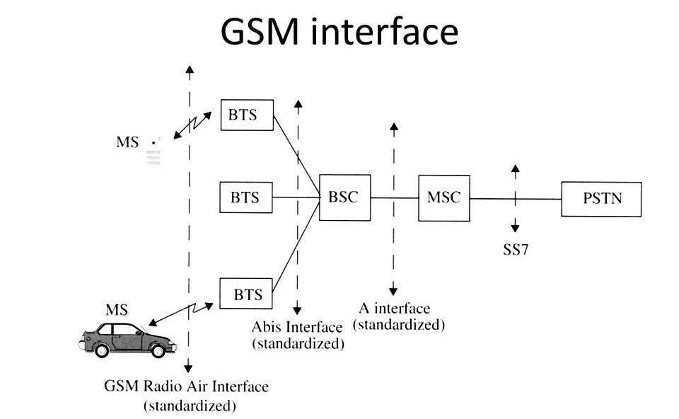

Slide 21
Network Signaling in GSM
GSM signaling defines the communication between the mobile and the network.
Signaling has to be carried through the network and across the air interface to the mobile.
Different protocols are used across different interfaces.
All GSM signaling is based on Open System Interconnect(OSI) model used for computer system.
The signaling protocol in GSM is structured into three layers:
Layer 1:Physical Layer- is providing media for communication
Layer2: Data Link Layer: Error Detection & Correction
Layer 3: Network Layer: Communication

Slide 22
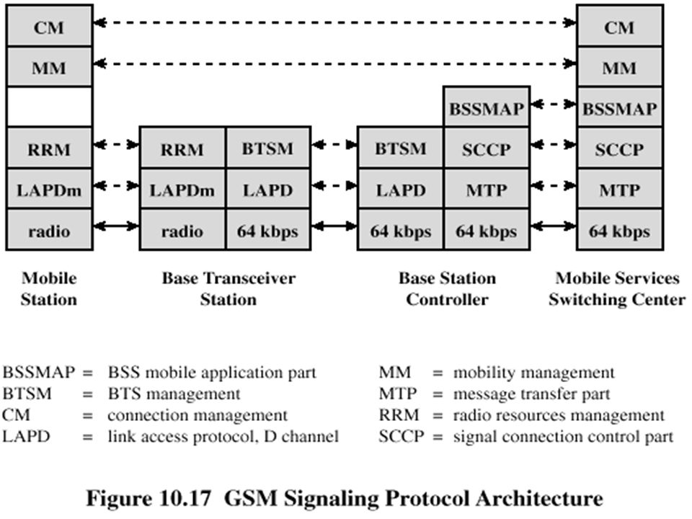

Slide 23
MS-BTS: The physical layer between MS and BTS is called Um or air interface and perform functions full or half duplex access, provides TDMA, FDMA & CDMA, framing of data.
The Data link layer control the flow of packets to and from network and provides access to various services like:
Connection: provides connection between two terminal
Teleservices: MMS,SMS, fax etc.
The data link present between MS & BTS is called LAPDm and functions are data flow control, acknowledged/ unacknowledged data transmission, segmentation , address and sequence number check.
CM: Connection Management
Supports call establishment, maintenance, termination
Support Functioning of SMS
Support Dual Tone Multiple frequency (DTMF) signaling

Slide 24
MM (Mobility Management):
Control the issue regarding mobility management, location updating & registration.
RRM (Radio Resource Management)
Manages radio resources such as: frequency assignment, signal measurement.
BTS-BSC signaling protocols:
The physical layer between BTS and BSC is called Abis interface, where, voice is coded by using 64 kbps. The connection between BTS and BSC is through wired network. The data link layer is LAPDm. Network layer protocol is BTS management which interact with BSSAP.

Slide 25
BSC-MSC Signaling protocols:
Physical layer between BSC and MSC is called A interface. Data link layer protocol between BSC and MSC is MTP(Message Transfer Protocol) and SCCP (Signaling Connection Control Protocol). MTP and SCCP are part of SS7. Network layer protocols are the MSC are CM, MM and BSSAP.
Mobility Management in GSM:
Mobility management function handles the function that arises due to mobility of the subscriber.
Main objective of MM is location tracking & call setup.
Registration Process of MS moving from one VLR to another VLR.

Slide 26
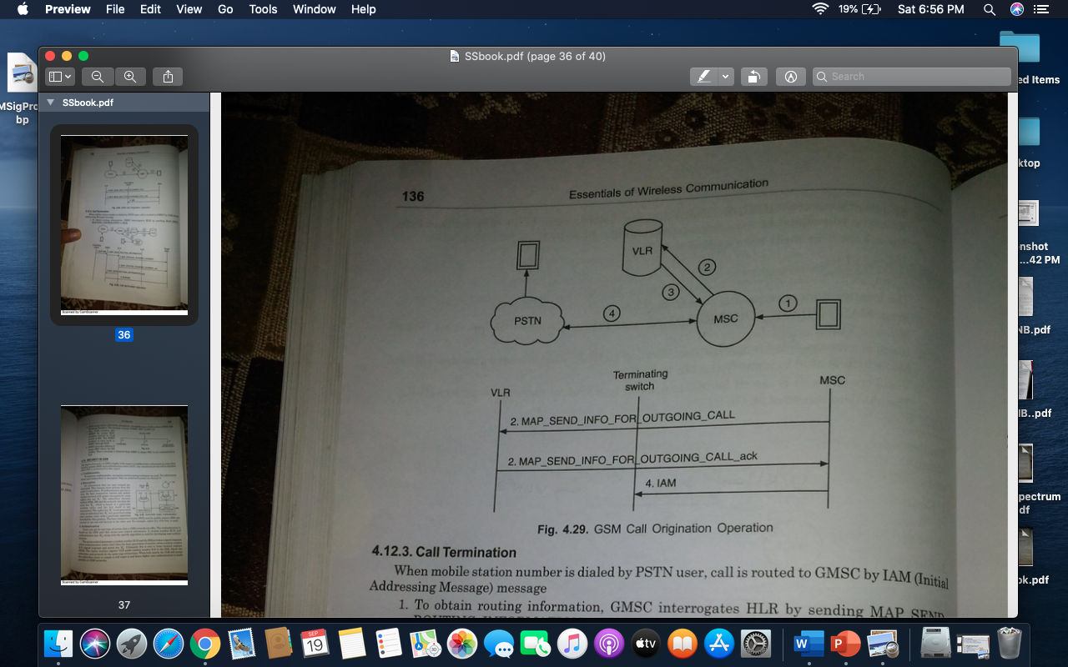
GSM Call organization
MS sends the call organization request to MSC.
MSC forwards the request to VLR by sending MAP_SEND_INFO_FOR_OUTGOING_CALL.
VLR checks MS’s profile and sends an ACK to MSC to grant call request.
MSC set up communication link according to standard PSTN call setup procedure.

Slide 27
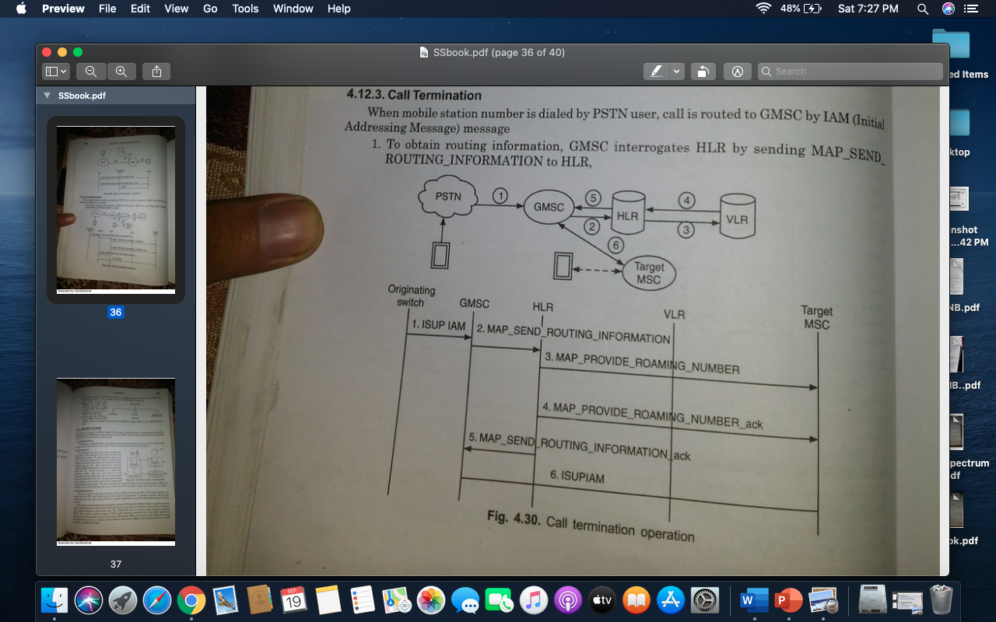
GSM Call Termination
To obtain routing information, GMSC interrogates HLR by sending MAP_SEND_ROUTING_INFORMATION to HLR.
HLR sends a MAP_PROVIDE_ROAMING_NUMBER msg to VLR to obtain MSRN (MS Roaming Number). The message consists of IMSI, MSC number etc.
The VLR creates the MSRN by using MSC number stored in VLR record of MS. The MSRN number is sent back to GMSC through HLR.
MSRN provides address of target MSC where the MS resides. Then a message is directed from GMSC to target MSC to set communication link.

